Slide 1
Securing a WebApp
Prepared by Dipen Patel
2025ICS-008

Slide 2
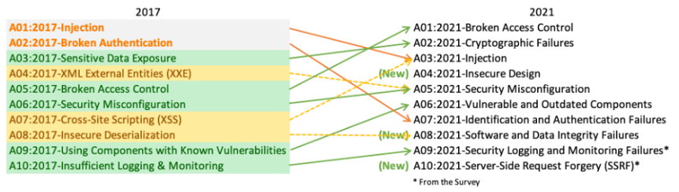
MERN Landscape and OWASP top 10
MERN Landscape: Frontend(React), Backend(Node/Express), Database(MongoDB), Service(Azure)
WebApp: CRM(Customer Relationship Management)
OWASP Top 10: List of critical web security risks
Approach: Address a risk and implement a Security Solution

Slide 3
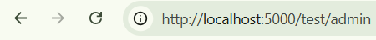
Broken Access Control
Access Control: Who cam perform which action or access which resources
Examples of broken access controls:
Vertical privilege escalation
a low level user gains admin functions
Horizontal privilege escalation
A user accesses another same level users resources
Common Reasons for broken access controls:
Unprotected functionality | Endpoint
Lack of Authentication and Request Validation
No proper User structure

Slide 4
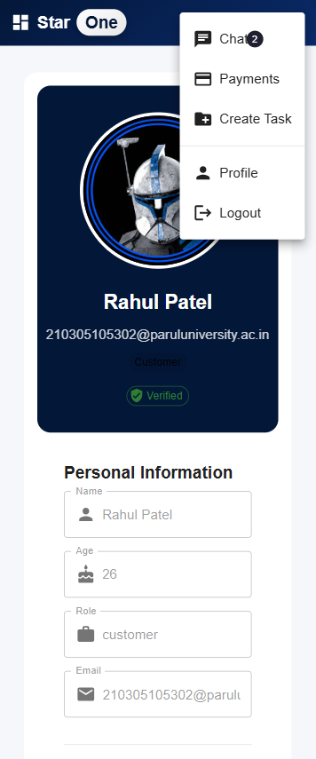
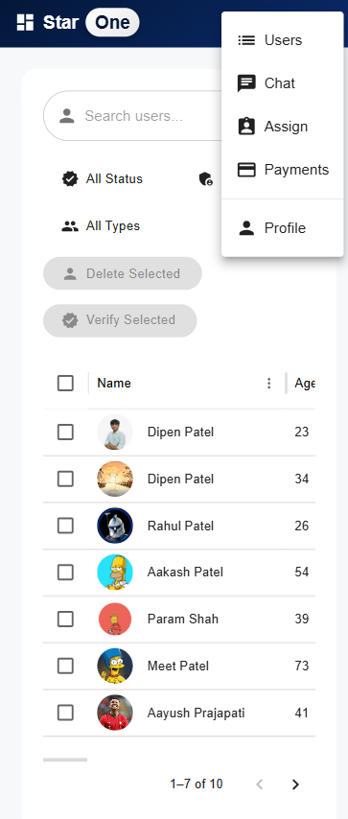
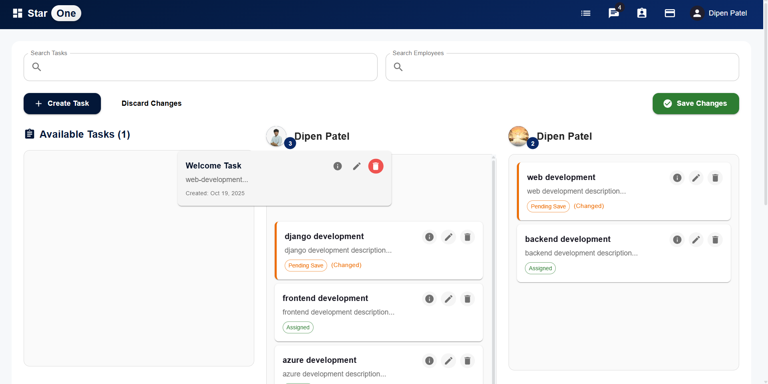
Broken Access Control
Mitigation:
Well defined Role-Based Access Control (RBAC)

Slide 5
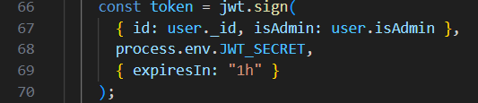
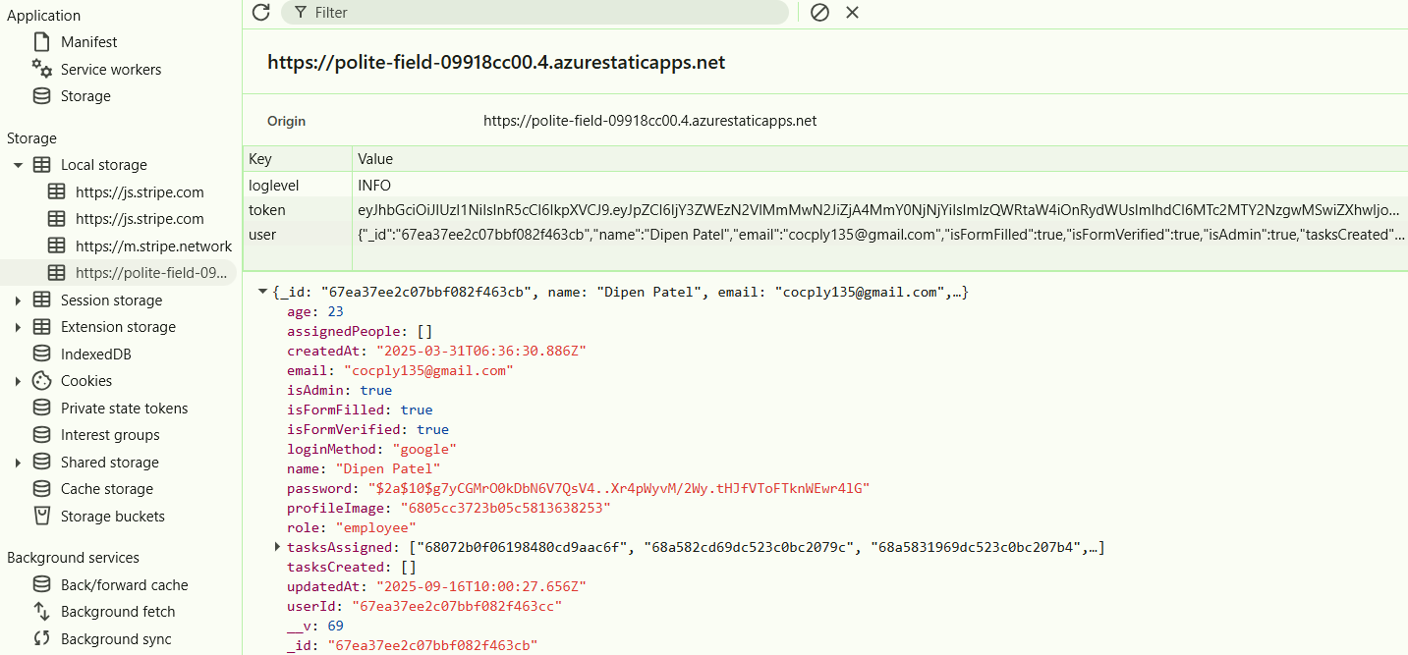
Broken Access Control
Mitigation:
Make use of Tokens to validate the user roles

Slide 6
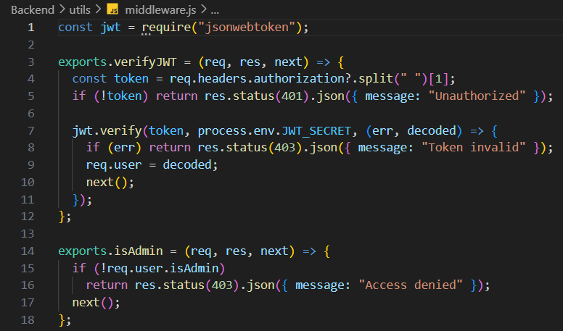
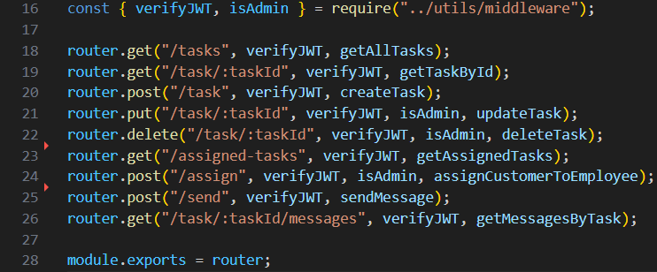
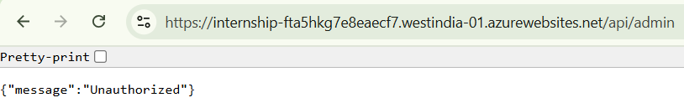
Broken Access Control
Mitigation:
Middleware for role checks and permission checks(Make sure all endpoints are covered)

Slide 7
Cryptographic Failures
expose sensitive data to attackers, such as passwords, credit card numbers, and personal identification numbers
Common Reasons for broken access controls:
Not Using Encryption
Insecure Cryptographic Functions
Improper Key Management
Unprotected Environment Variables

Slide 8
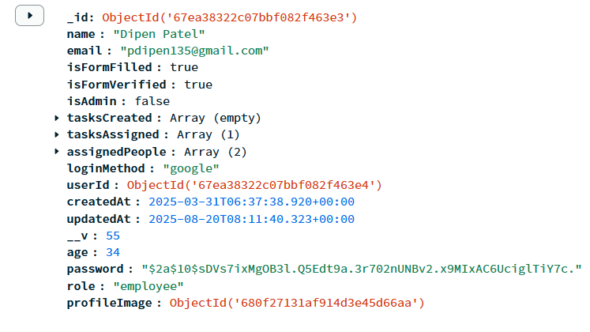
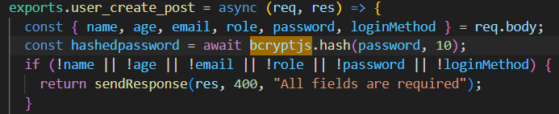
Cryptographic Failures
Mitigation:
Use bcrypt for Password Hashing
Update the Encryption Dependencies with time

Slide 9
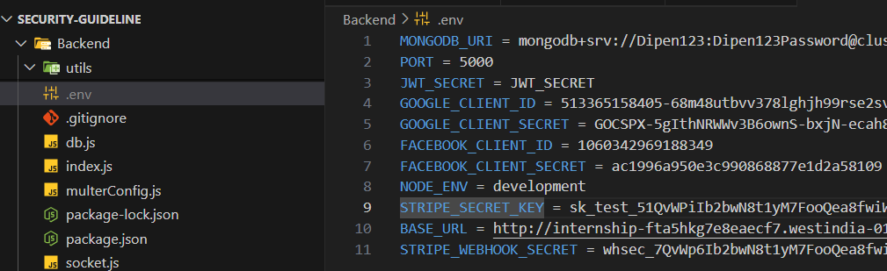
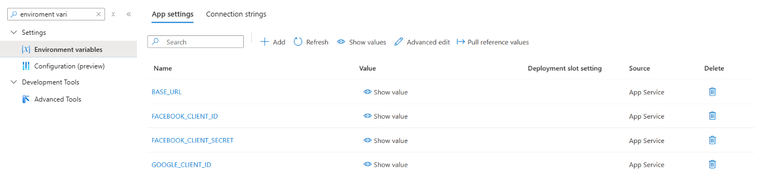
Cryptographic Failures
Mitigation:
Hide the Environment variables in .env while development
Define Environment variables in Hosting Service

